Slide 1
FunctionaL Omics Preprocessing benchmarking:
Exploring the effects of alternative omics preprocessing pipelines in downstream functional results
Víctor Patón González
www.saezlab.org
@saezlab
Notes:
Welcome everyone to my presentation of the results of the Project I have been working on in the last couple months. The Project, called functional omics preprocessing benchmarking, Will explore the effects of alternative omics preprocessing pipelines in downstream functional results. If something is not clear, please interrupt me and we can go through it again.

Slide 2
Hypothesis and general lines of the project
Hypothesis: the choice of specific normalization and differential expression analysis tools during bulk RNAseq data analysis might have a significant effect on the resulting functional space
Methodology: implementation of a workflow combining several methods for normalization and differential expression analysis, followed by the fitting of non-linear mixed effects models for statistical analysis.

Slide 3
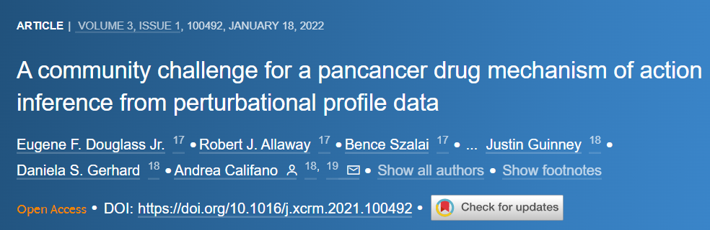
Datasets
PANACEA: Drug-perturbed RNAseq dataset on cancer cell lines
11 Cell lines
32 treatments + ctrl(DMSO)
352 datasets Treatment - Control

Slide 4


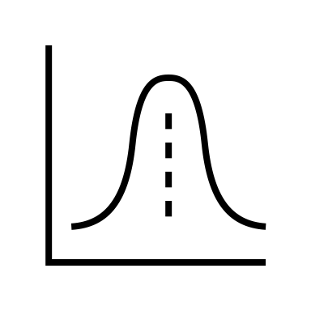
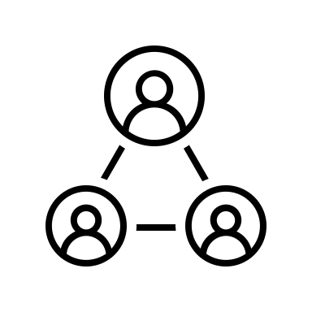

Workflow
vsn
qnorm
Limma
DecoupleR
Functional scores
Counts
TMM
Normalised counts
Differential expression
$$α f(x)$$
Scaling factors
Metadata
EdgeR
DESeq2

Slide 5
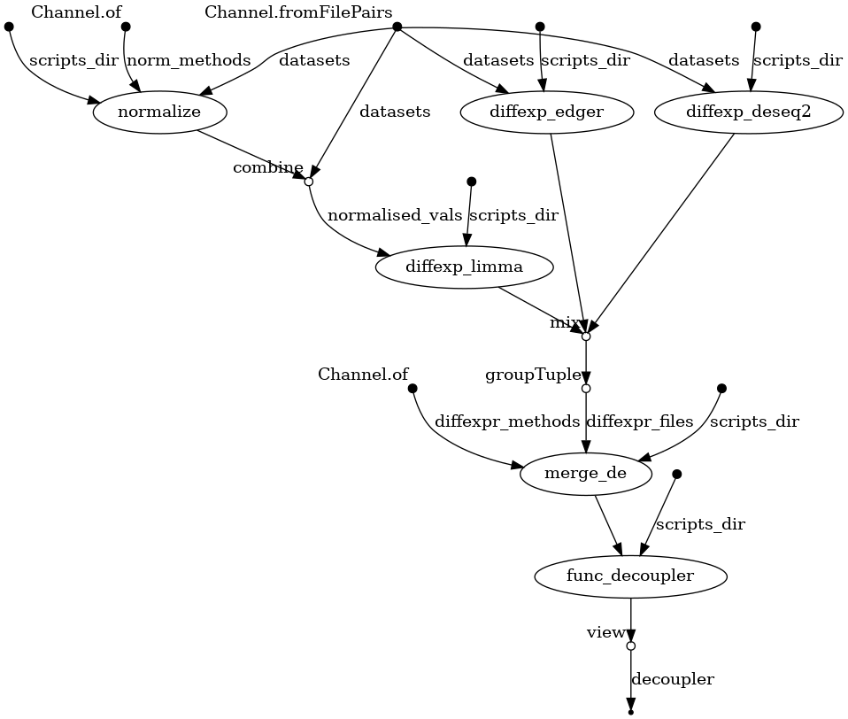
Workflow
Normalization: vsn, tmm, logquant
Differential expression: edgeR, limma, DESeq2
Statistics: t-values, logFC
Progeny as source of prior knowledge
A Nextflow workflow was created to parallelise tasks for more computational efficiency, scaling and reproducible analysis

Slide 6
Statistical analysis
Layers of complexity:
Normalization
Differential expression
Pathway
Cell line
Treatment
Statistic used as input to Decoupler
Fixed effects
Random effect

Slide 7
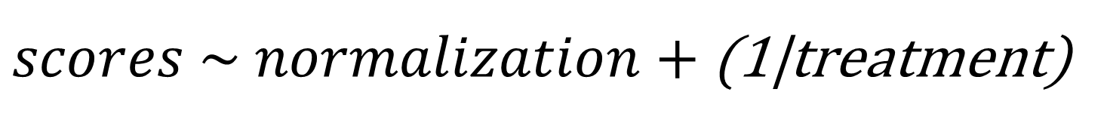
Statistical analysis
2 different nonlinear mixed-effects models fitted, one for each fixed effect:
$scores \sim normalization+$ (1|treatment)
$scores \sim differential expression+$ (1|treatment)
Treatment is a random effect, normalization and differential expression are fixed effects

Slide 8
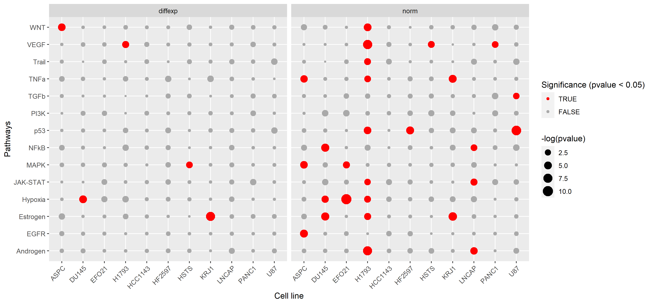
Statistical analysis
Using t-stats as input for Decoupler:

Slide 9
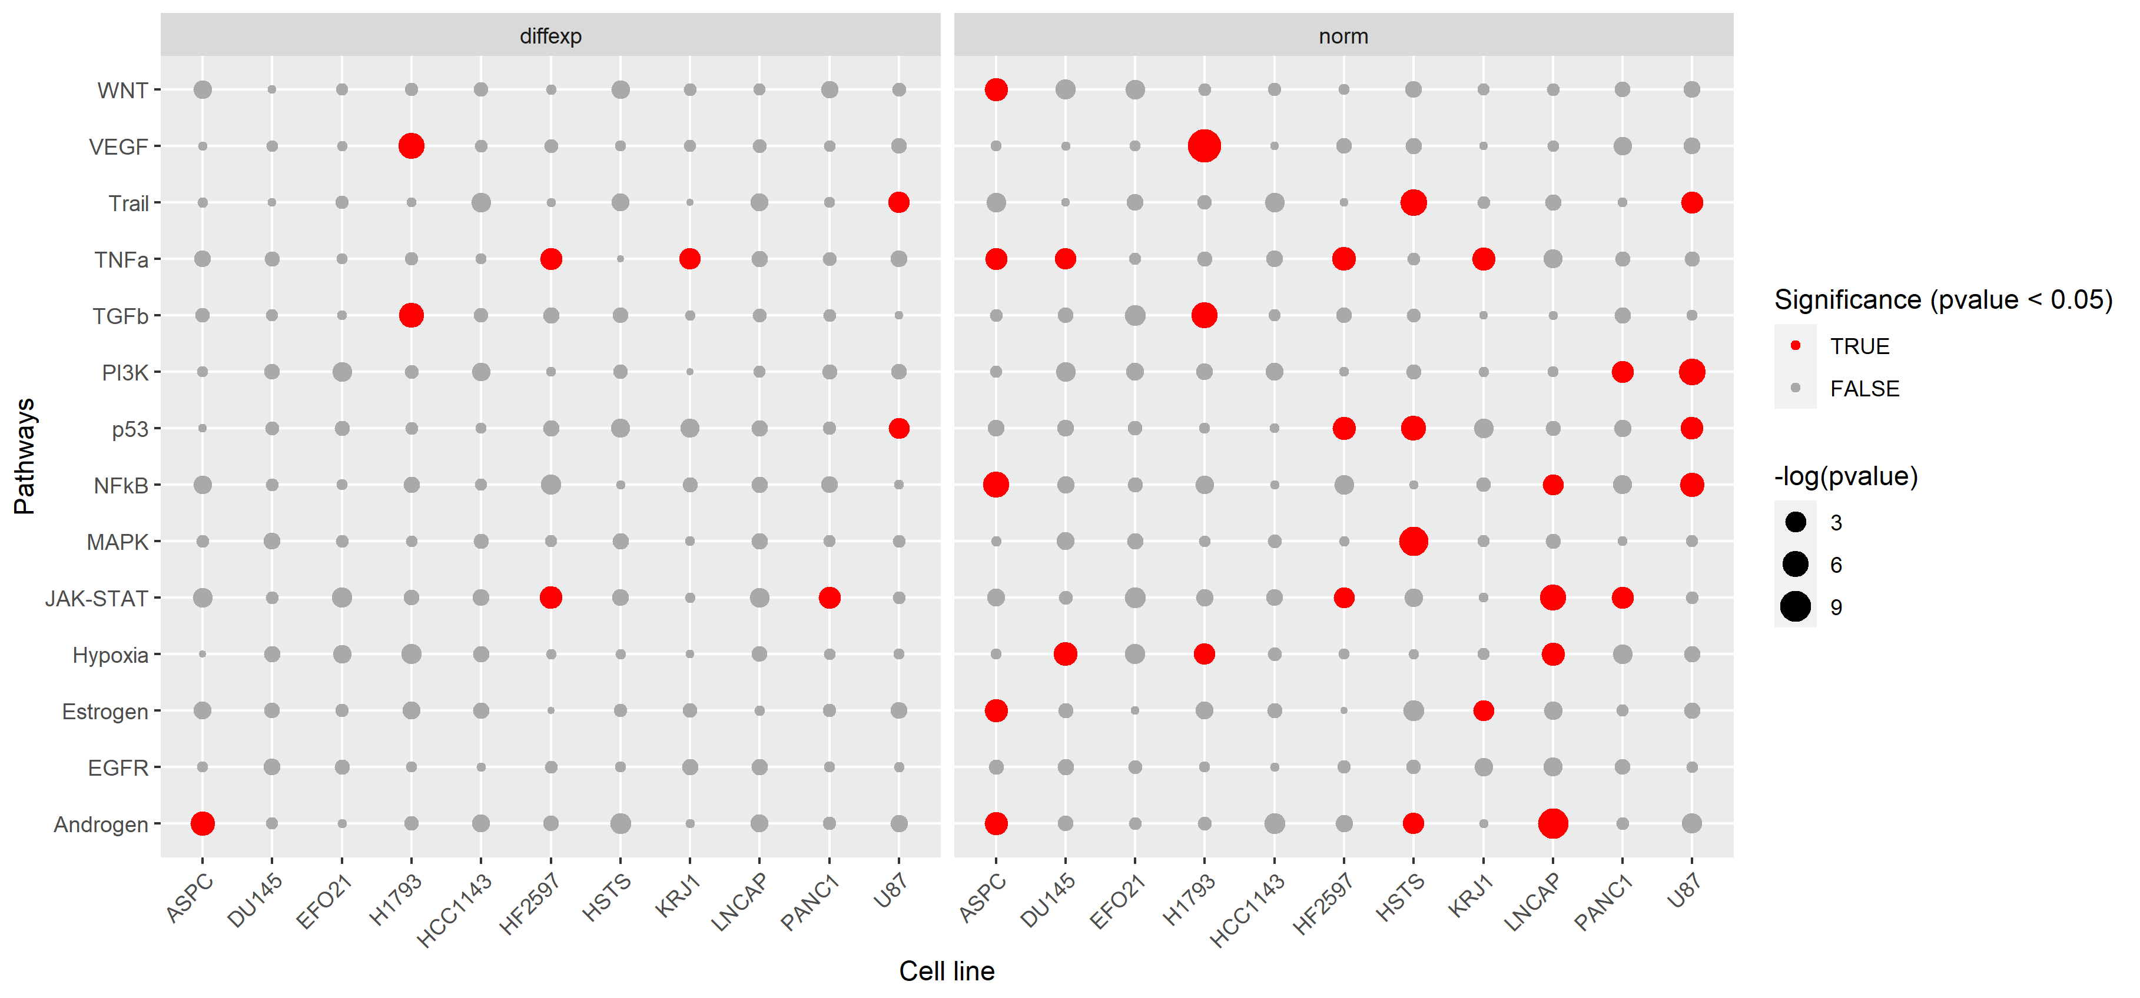
Statistical analysis
Using logFC as input for Decoupler:

Slide 10
Statistical analysis
P values were also combined across pathways and cell lines

Slide 11
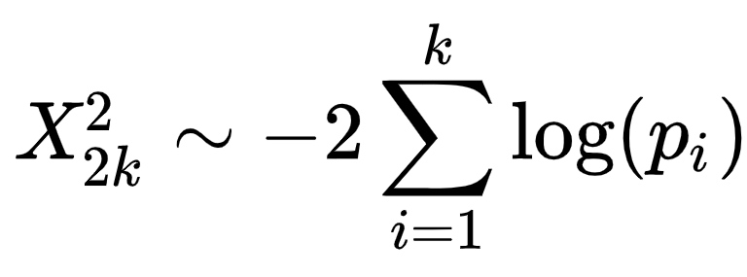
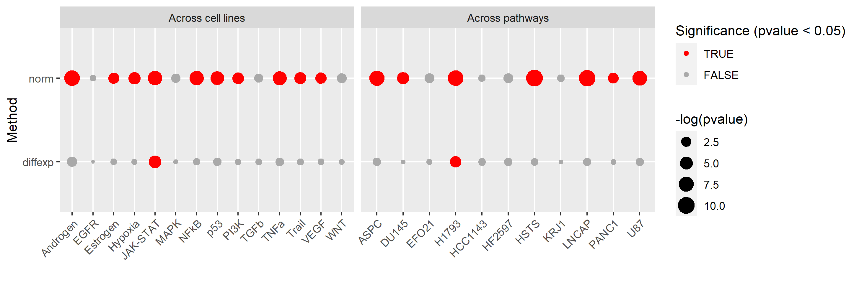
Statistical analysis
P values were also combined across pathways and cell lines
Fischer’s method of sum of logarithms was used:

Slide 12
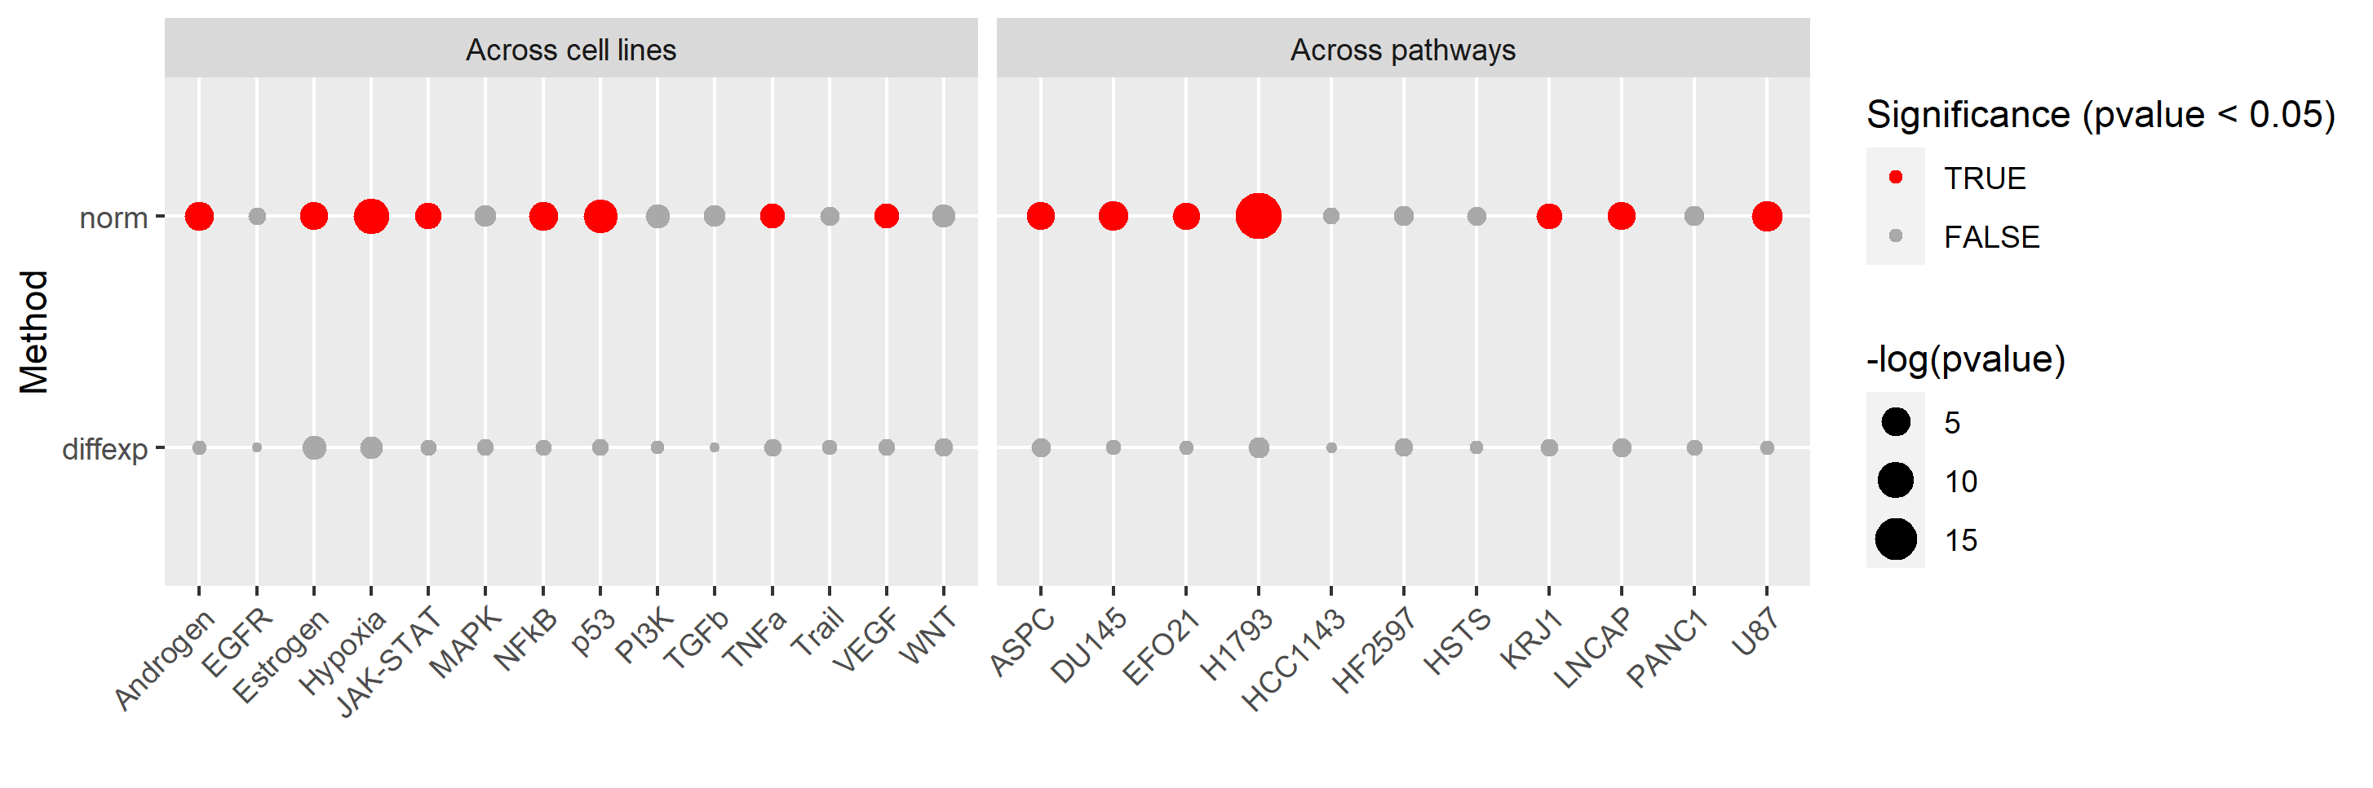
Statistical analysis
T-values
logFC

Slide 13
Conclusions
Conclusions:
There were significant differences when comparing different normalization methods, in contrast to few significant differences when fitting for differential expression methods.
The greater importance of normalization over differential expression methods in variance explanation was consistent across cell lines, pathways and parameters used in Decoupler

Slide 14
Questions / comments?

Slide 15
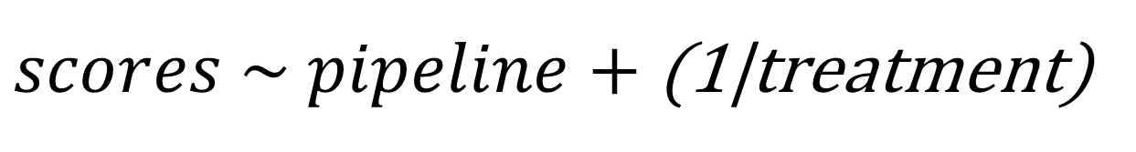
Additional: Statistical analysis
Normalization and differential expression were combined in a single variable, called pipeline, resulting in 5 different pipelines.
A non-linear mixed-effects model was fitted:
$scores \sim pipeline+$ (1|treatment)
Treatment is a random effect, pipeline is a fixed effect

Slide 16
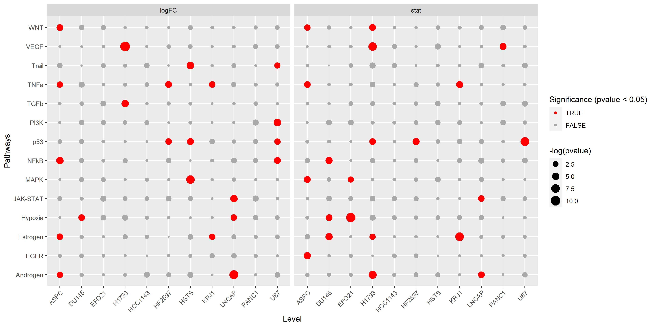
Additional: Statistical analysis
Using logFC or t-values as input for Decoupler:

Slide 17
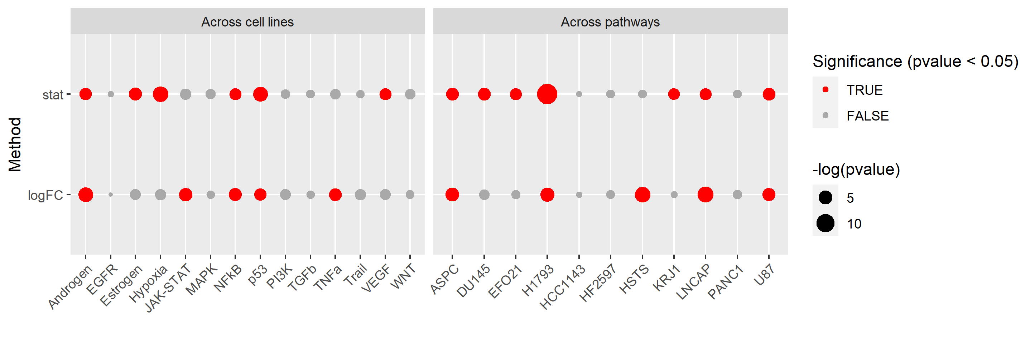
Additional: Statistical analysis
P values were also combined across pathways and cell lines
Fischer’s method of sum of logarithms was used:

